Slide 1
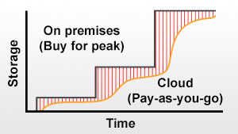
S3 and EBS for Your Storage Needs
Amazon S3 – Object Storage
Highly scalable, high performance.
Can access directly from the internet.
Integrates with CloudFront (CDN).
Perfect for back-up and archiving.
Amazon EBS -- Block Storage
Snapshotting – long term durability.
Provisioned IOPS or Standard volumes.
Amazon Glacier -- Archive Storage
Extremely low-cost optimized for infrequent access.

Slide 2
Amazon Elastic Block Store
Amazon Elastic Block Store (EBS) provides block level storage volumes for use with Amazon EC2 instances. Amazon EBS volumes are network-attached, and persist independently from the life of an instance.
Amazon EBS provides highly available, highly reliable, predictable storage volumes that can be attached to a running Amazon EC2 instance and exposed as a device within the instance.
Amazon EBS is particularly suited for applications that require a database, file system, or access to raw block level storage.

Slide 3
Amazon Elastic Block Store
Amazon EBS offers persistent storage for Amazon EC2 instances. Amazon EBS volumes provide “off-instance” storage that persists independently from the life of any instance.
Amazon EBS volumes are highly available, highly reliable data shares that can be attached to a running Amazon EC2 instance and are exposed to the instance as standard block devices.

Slide 4
Amazon Elastic Block Store
Amazon EBS volumes are automatically replicated on the back end.
The service provides users with the ability to create point-in-time snapshots of their data volumes, which are stored using the Amazon S3 service. These snapshots can be used as a starting point for new Amazon EBS volumes and can protect data indefinitely.

